Slide 1
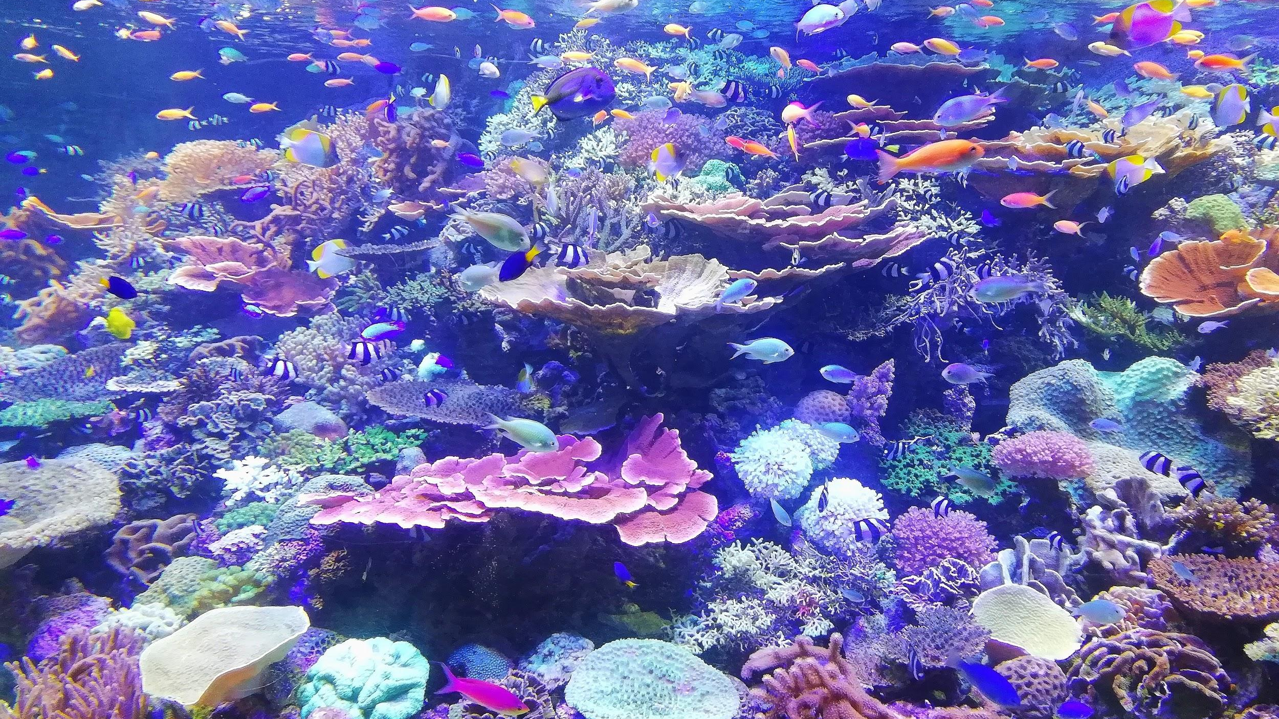
FOOD WEB IMPACTS 1
We will predict the effects of introduced species and population changes on local habitats using food webs.
Notes:
Insert cover image and use transparency settings to fade image.

Slide 2
Do not delete this slide.
This slide is designed so that you can copy the prompt box you need and insert it into your slides.
This slide is hidden and will not be included when presenting your lesson.
TRACK WITH ME
VOCABULARY
1 -
HINT
Students, remember….
CHECK FOR UNDERSTANDING
READ WITH ME
TEACHER CUE
MAKE THE CONNECTION
Students, you already know….
EXTENSION
GESTURE WITH ME

Slide 3
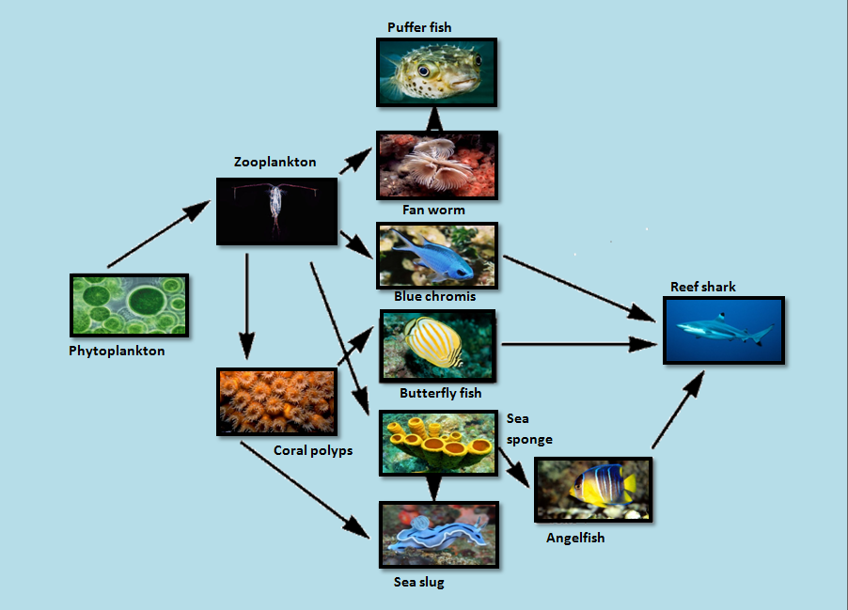
Construct as many food chains as you can from this example of an Australian coral reef ecosystem.
Coral polyps

Slide 4
Repeat the opposite word/phrase.
ORGANISM
LIVING THING

Slide 5
Repeat the opposite word/phrase.
CLASSIFICATION
SORTING BY CHARACTERISTICS

Slide 6
Repeat the opposite word/phrase.
HABITAT
WHERE AN ORGANISM LIVES

Slide 7
Repeat the opposite word/phrase.
FOOD CHAIN
SHOWS TRANSFER OF ENERGY BETWEEN ORGANISMS

Slide 8
Repeat the opposite word/phrase.
FOOD WEB
SHOWS TRANSFER OF ENERGY WITHIN ECOSYSTEMS

Slide 9
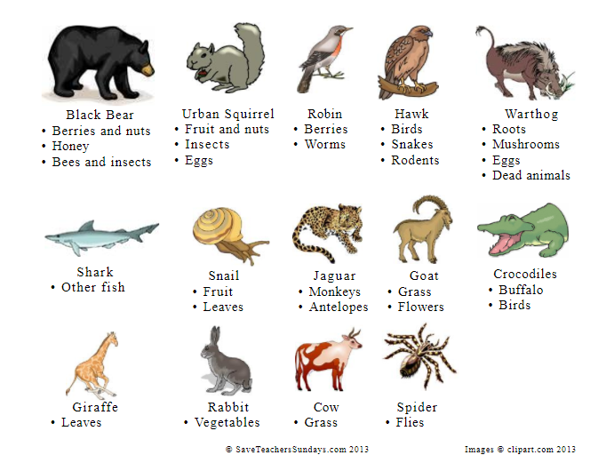
Identify whether the animals are herbivores, omnivores or carnivores:
Black Bear
Shark
Hawk
Snail
Robin
Cow

Slide 10
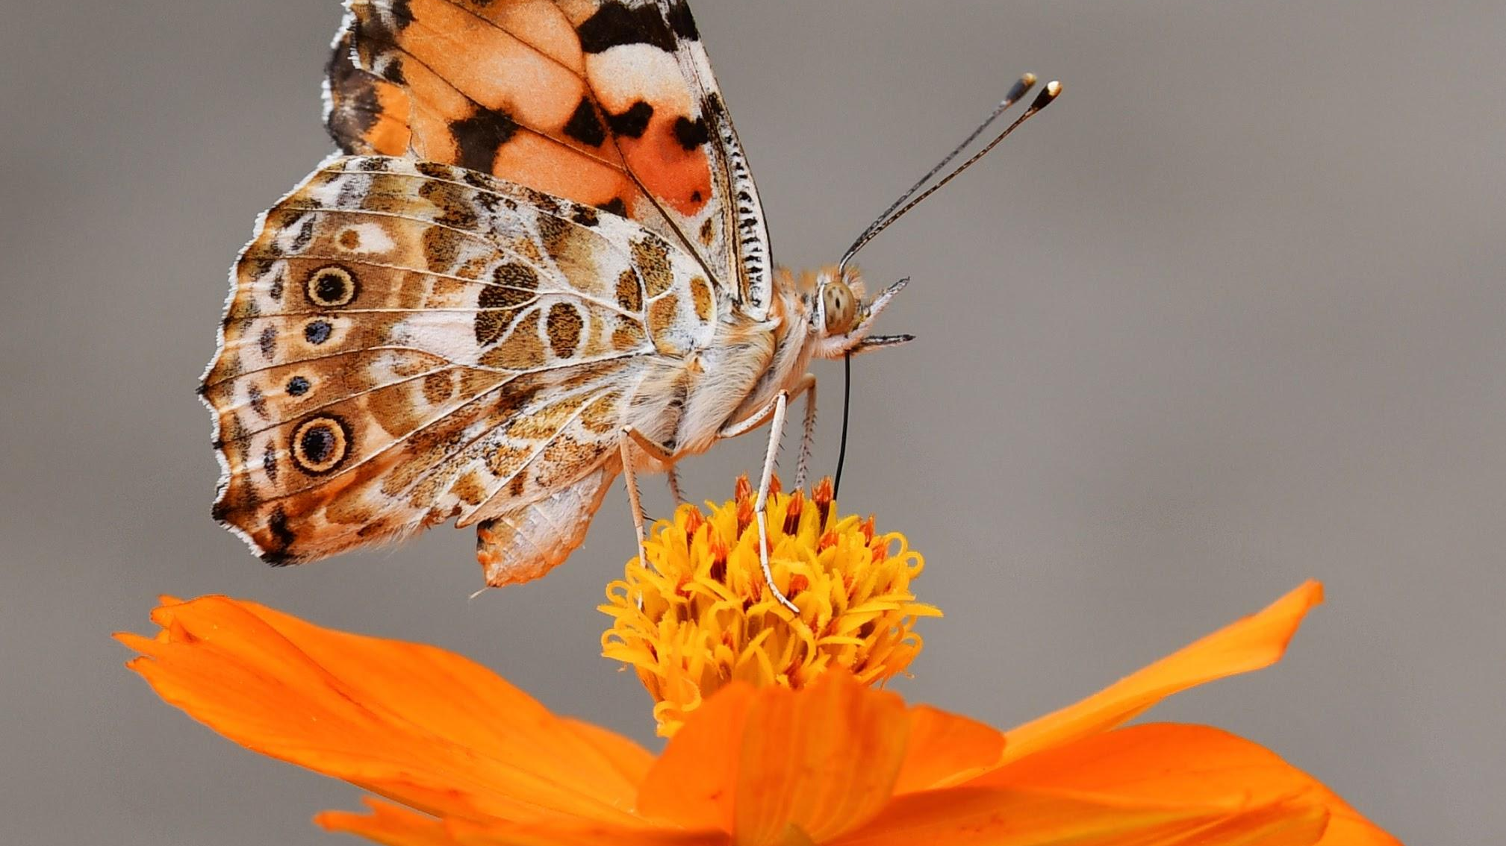
In this experiment, 30 butterflies were offered three different food options: flowers, honey or sugar water. A dish of each food option was put into the butterfly enclosure and the amount of butterflies feeding on each food option was counted.
Results:
Flowers: 18 butterflies
Honey: 0 butterflies
Sugar water: 12 butterflies
Dependent variable (measured): __________
Independent variable (changed): ____________
2 control variables: _____________________
What could a conclusion for this experiment be?

Slide 11
We will predict the effects of introduced species and population changes on local habitats using food webs.
TRACK WITH ME
READ WITH ME
We will define introduced species.
We will define population.
We will use local examples of introduced species or population changes affecting local habitats.
DECLARE THE OBJECTIVE
Read the learning objective to your partner.
Notes:
Learning Objectives contain concepts (nouns, big ideas), skills (verbs, measurable behaviours) and sometimes context (restricting or targeting conditions).
●Example: Students will be able to describe the concept of density and apply it to floating and sinking.
●
Success criteria are specific measurable outcomes that if met mean that the student has met the learning objective.
Examples:
•Students will be able to compare densities of substances using mass and volume.
•Students will be able to identify whether a solid or liquid will float or sink in a liquid based on their densities.

Slide 12
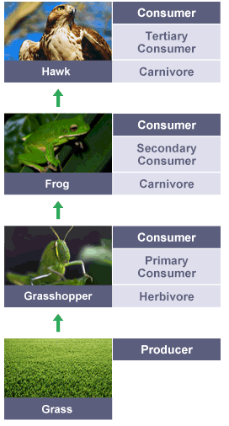
We will predict the effects of introduced species and population changes on local habitats using food webs.
A food chain shows how energy is transferred from one living organism to another via food.
A food web shows how energy is transferred between organisms in an ecosystem via food.
There are factors that affect how much food is available to organisms.
What would happen to the frogs and hawks if all of the grasshoppers died due to pesticides₁?
VOCABULARY
1 - substance to destroy pests

Slide 13
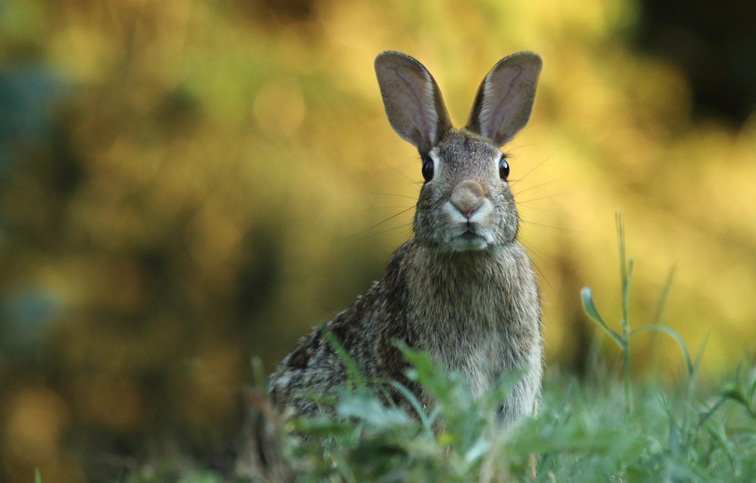
We will predict the effects of introduced species and population changes on local habitats using food webs.
There are many different organisms that live in an ecosystem. Within an ecosystem there are populations of organisms.
A population is all the members of a single species that live in a habitat.
Some organisms within an ecosystem have been introduced by humans into the ecosystem, either accidentally or on purpose.
Introduced species are organisms that are not native₁ to the area.
CHECK FOR UNDERSTANDING
Rabbits arrived in Australia with the First English Fleet in 1788. Would rabbits be considered an introduced species in Australia?
VOCABULARY
1 - occurring naturally in a particular place.

Slide 14
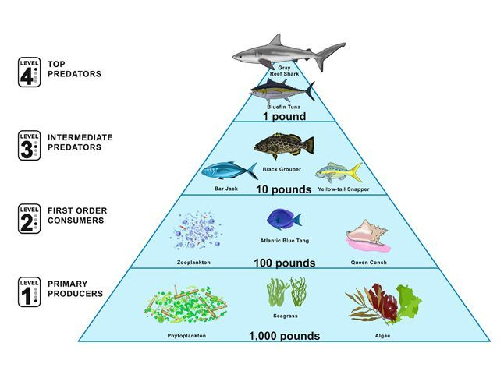
We will predict the effects of introduced species and population changes on local habitats using food webs.
CHECK FOR UNDERSTANDING
Why would there be less sharks (tertiary consumers) in this food web than algae (producer)?
Most food webs in an ecosystem have a balance between the populations of producers and consumers.
The largest populations will be the producers, with the populations of consumers moving up the food chain getting smaller at each trophic level.
Populations get smaller moving up the food chain because energy transfer between trophic levels is inefficient, with only around 10% of the energy being transferred each time.
This balance can be disrupted by the introduction of new organisms (introduced species) or the decrease of populations and removal of species.

Slide 15
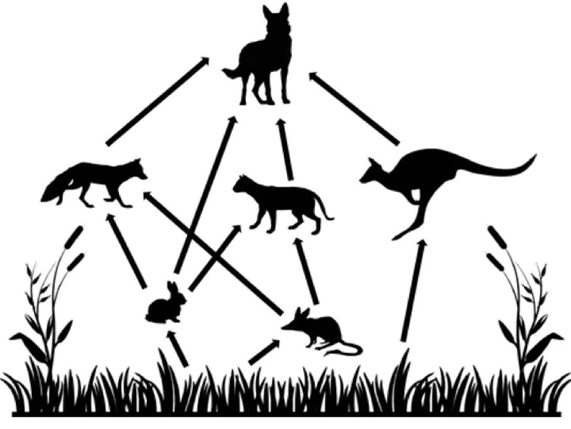
We will predict the effects of introduced species and population changes on local habitats using food webs.
CHECK FOR UNDERSTANDING
Identify in the food web below: Two organisms in competition. An example of predation.
A population is all the members of a single species that live in a habitat.
A population change₁ can occur because of a number of factors:
Competition - when organisms are competing for the same limited resources. e.g. the rabbit, bilby and kangaroo all compete for grass.
Predation - one organism kills another for food. e.g. the dingo eats kangaroos.
Disease - organisms die due to illness.
Changes in environmental conditions - organisms move away or die due to limited resources e.g. drought
Dingo
Fox
Kangaroo
Feral Cat
Rabbit
Bilby
VOCABULARY
1 - change in the number.

Slide 16
We will predict the effects of introduced species and population changes on local habitats using food webs.
CHECK FOR UNDERSTANDING
How have the following organisms impacted this food web? Rabbits? Feral Cats?
When new species are introduced to an area they can cause population changes due to increasing competition for resources and possibly increasing predation of organisms.
In the food web on the right rabbits, foxes and feral cats are introduced species to Australia. These introduced species impact on this food web.
For example, foxes eat native bilbys reducing their population numbers by increased predation.
Dingo
Fox
Kangaroo
Feral Cat
Rabbit
Bilby

Slide 17
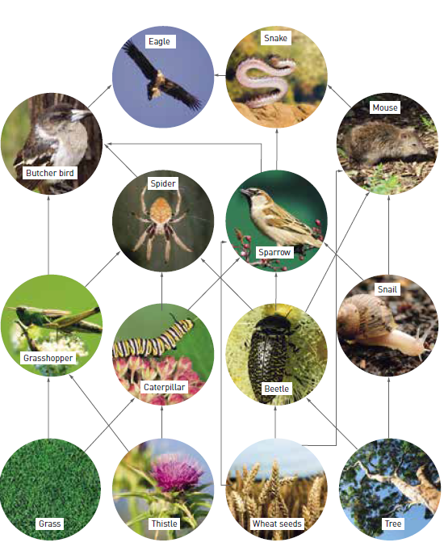
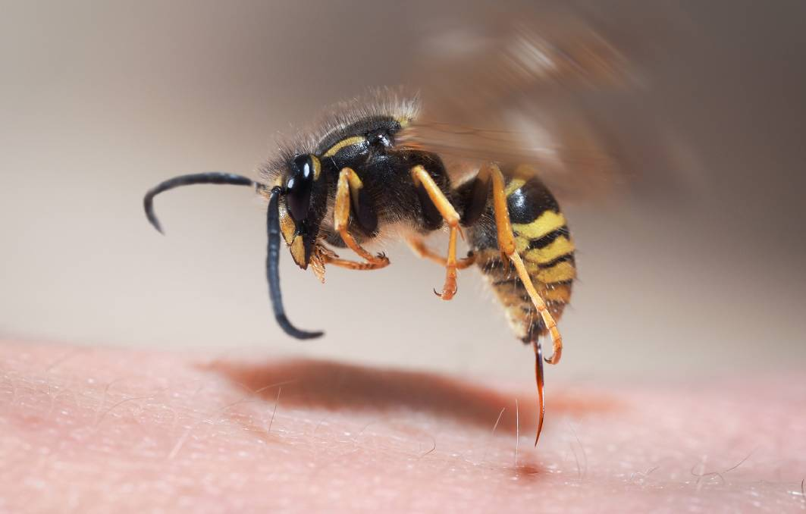
We will predict the effects of introduced species and population changes on local habitats using food webs.
The European paper wasp was accidentally introduced into WA in 1986 through wood shipments.
Each European wasp nest may contain several thousand insects which eat a diet of native insects such as caterpillars, flies, grasshoppers, beetles, moths and butterflies.
European Paper Wasp
HINT
Competition Predation
CHECK FOR UNDERSTANDING
What are some of the impacts introducing the European paper wasp would have on this food web?

Slide 18
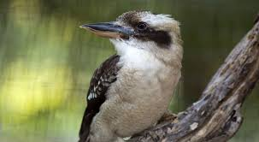
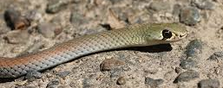
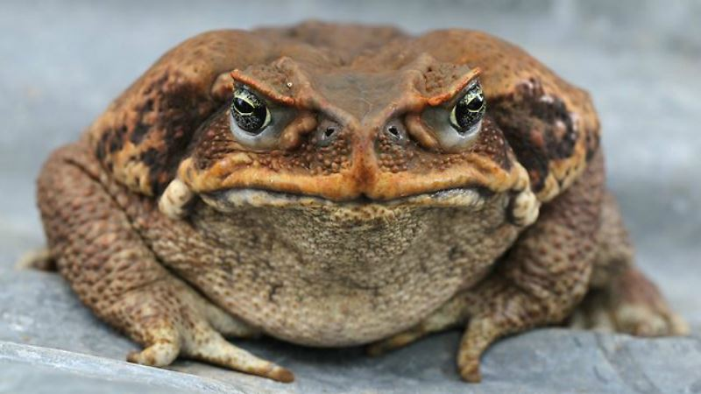
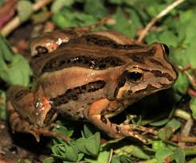
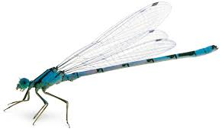
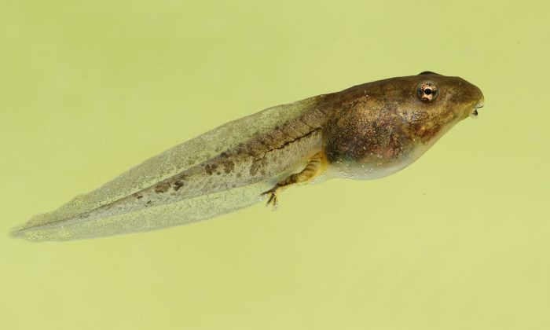
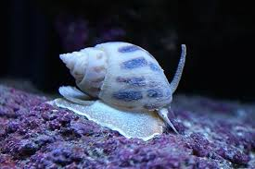
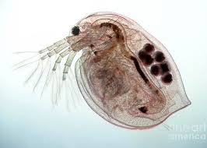
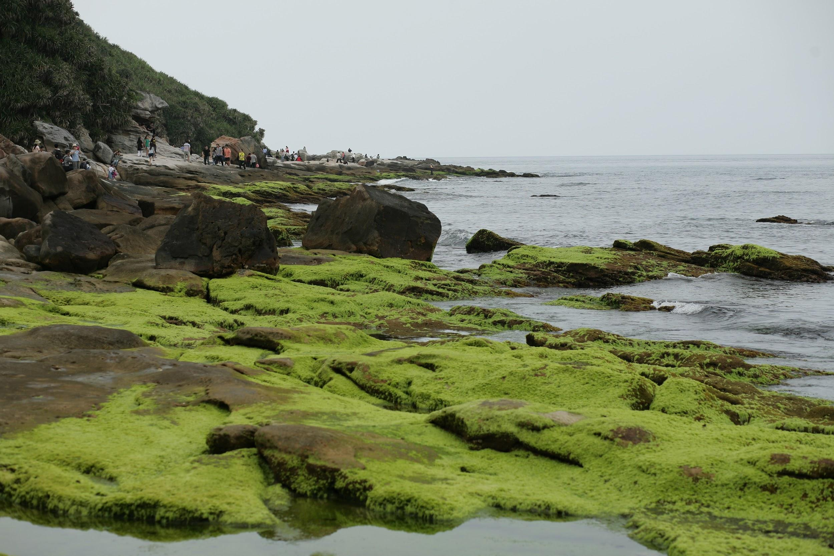
HINT
Competition Predation
We will predict the effects of introduced species and population changes on local habitats using food webs.
Cane toads were introduced to Australia in 1935 to control the cane beetle.
They are extremely poisonous – predators who attempt to eat them will usually become very ill and in some cases die.
Kookaburra
Cane toads eat almost anything they can swallow. This includes beetles, bees, ants, termites, crickets, snails, smaller toads and native frogs, small snakes, and small mammals.
Snake
Cane Toad
Native frog
Damselfly
Tadpole
Aquatic snail
Daphnia
CHECK FOR UNDERSTANDING
What are some of the impacts that introducing the cane toad would have had on this food web?
Algae

Slide 19
We will predict the effects of introduced species and population changes on local habitats using food webs.
When corals are stressed by changes in conditions such as temperature, light, or nutrients, they expel the symbiotic algae living in their tissues, causing them to turn completely white (coral bleaching).
CHECK FOR UNDERSTANDING
What would happen in this food web if all coral died?
Coral
If the algae loss happens over a longer period of time and the stress continues the coral eventually dies.

Slide 20
We will predict the effects of introduced species and population changes on local habitats using food webs.
Ecosystems are complex and changes for one organism can impact the whole system.
Food webs allow us to identify the effects of ecosystem change more easily.
CHECK FOR UNDERSTANDING
Would a food chain or a food web be better to see the impacts of change on the whole ecosystem?
Dingo
Fox
Kangaroo
Feral Cat
Rabbit
Bilby

Slide 21
We will predict the effects of introduced species and population changes on local habitats using food webs.
CHECK FOR UNDERSTANDING
What would happen to the populations of organisms in this ecosystem if there was a drought?
There are many different organisms that live in an ecosystem, often represented using food webs. Within an ecosystem there are populations of organisms.
A population change₁ within an ecosystem can occur because of a number of factors:
Competition
Predation
Disease
Changes in environmental conditions
Changes in a population within an ecosystem will impact on the other species in a food web due to modified competition for resources and changes to predator-prey relationships.
Dingo
Fox
Kangaroo
Feral Cat
Rabbit
Bilby
EXTENSION
What would happen to Bilby and Kangaroo populations if the rabbits were removed from this food web by disease?

Slide 22

We will predict the effects of introduced species and population changes on local habitats using food webs.
Complete the questions below in your book.
What is a population?
What is an introduced species?
What factors can cause population changes?
Using the food web on the right:
What impact is the introduced species mouse having on this food web?
Which species would be affected if dieback disease reduced the health of the trees and their population decreased?
Notes:
Please include tasks/questions here rather than just referring to a worksheet. This will save on photocopying and facilitate sharing with other schools.
Try and build tasks/questions which escalate through Bloom’s Taxonomy. This will help with differentiation.

Slide 23
We will predict the effects of introduced species and population changes on local habitats using food webs.
We will define introduced species.
We will define population.
We will use local examples of introduced species or population changes affecting local habitats.
CHECK FOR UNDERSTANDING
Check Success Criteria.

